Slide 1
MSCA 31008 Boot Camp Review
Week 3

Slide 2
Week 3 Agenda
Confidence Intervals
Degrees of Freedom
Difference Between the Means
Tukey’s HSD
Bonferroni
Specific Comparisons
Pairwise Comparisons

Slide 3
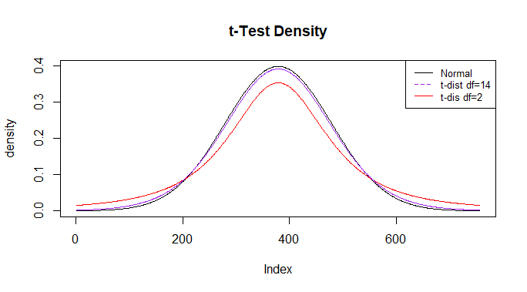
T-Distribution
As the df increases the t-value for .05 comes closer to the normal standard deviation of 1.96. Check the previous chart, .05 two-tails at df=120 the t-value is 1.98.
Fat tails mean that more of the distribution is farther from the mean

Slide 4
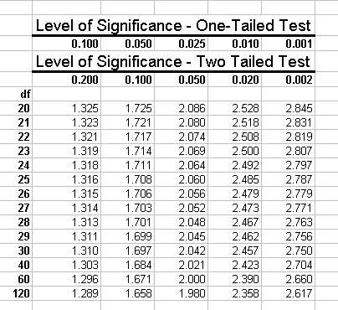
Degrees of Freedom
Degrees of Freedom are based on the number if INDEPENDENT pieces of information: Which is usually calculated as N-1
For a group of three that has a mean of 10, the first two items could be 8 and 13 but then the third must be 9, which isn’t independent.

Slide 5
Confidence Interval
Inferential statistics is about trying to describe the population based on the sample you have.
The point estimate, the difference between the means, etc. is just one number.
A sample is unlikely to match the population mean.
What range, plus or minus, would you have to put on your single number it ensure that the population mean falls in that range?
If you do know the Pop. Variance, Normal Dist. 95% = Mean +/- (1.96) * (std. dev.)
If you don’t know the Pop. Variance, t-Dist. = Mean +/- (t-value) * (standard error)
_{What is it really good for?}
Correlation testing – CI should NOT include 0
Comparing 2 means – CI of the difference should NOT include 0
Proving that one test has an increase of over X, the lower CI should be greater than X

Slide 6
Standard Error of the Sampling Mean
Standard Error of the Mean is σ = σ/sqrt(N) and tells us how much variation there is in the sampling means
The more sampling you do the smaller the variability

Slide 7

Difference between the Means
Sampling distribution of the difference between the means:
μ_{Μ1-M2} = M₁-M₂
Standard Error of the Difference between POPULATION Means
Please note that there is a PLUS sign

Slide 8


Difference Between the Means – Samples We have to estimate the σ² when the population variance is unknown
MSE = Mean Square Error if your sample size are equal – if unequal use the Unequal Sample with harmonic mean procedure
Calculate your degrees of freedom: (n₁–1)+(n₂-1)
Find the t-value
95% CI = Mean+/- (t-value)*(S_{M1-M2})
=

Slide 9



Testing a Single Mean – Ex. DOG Scores
The special case of this formula applicable to testing a single mean is
The estimate of the standard error of the mean is computed as:

Slide 10
Difference Between 2 Means (Independent Groups)
:
The first step is to compute the statistic, which is simply the difference between means: M₁ - M₂
Calculate the Mean Square Error- MSE
Calculate the Standard Error –
Calculate the t-value – t= (M₁ - M₂) / Std Error
Compute the degrees of freedom (n₁–1)+(n₂-1)
Find the probability - p-value – for the t-value (two tailed).
Is it lower than .05? Then the value is significant.
=

Slide 11
Difference Between 2 Means (Correlated Pairs) Same as Testing a Single Mean
The special case of this formula applicable to testing a single mean is
The estimate of the standard error of the mean is computed as:

Slide 12
Knowing the Population Variance and Not Knowing it:
t=(statistic – hypothesized value)/Std Error
Chapter 9: When you know the variance Std Error is
Just the square root of the sum.
N = 20, M1 = 10, M2 = 5, V1 = 36, V2 = 64
Sd = sqrt(36/20 + 64/20) = 2.236
Normal dist = .98732
Chapter 12: When you have to estimate the variance
1. Find the average of the observed variances
2. Take the square root of 2*that average / n
MSE = (36+64)/2 = 50, Se = sqrt(2*50/20) = 2.236
t=(10-5) / .8366 = 2.236 df = 38, p = .982

Slide 13

Tukey’s HSD Test – All Pairwise Comparisons
This method reduces the risk of Type 1 error over the multiple comparisons
# of groups is the total combinations possible
MSE = mean of all of the groups
Q =
Df = (number of subjects in each group * number of groups) – (number of groups)
Use the t-distribution calculator to find the probability for each Q value
There are differences if the group sizes are unequal

Slide 14


Specific Comparisons (Independent Groups) Planned Comparisons
N = the total number of subjects
n = the number of subjects per group
K = the number of groups
Df = N-k
Calculate the mean and variance for each group
Based on the question being asked, determine the coefficients for each group
Multiply the coefficients and the means and sum them to get L
t-value is L divided by standard error multiplied by the sum of
square of the coefficients

Slide 15
Bonferroni Inequality - Unplanned Comparisons
Unplanned multiple comparisons can lead to Type I errors (rejecting the null when you shouldn’t)

Slide 16
POWER
The probability that the test correctly rejects the null hypothesis (H₀) when a specific alternative hypothesis (H₁) is true.
As statistical power increases, the probability of making a type II error (wrongly failing to reject the null) decreases.
Start by assuming that the means are different (you don’t know it but they are)
How to prove it?
What factors increase our power?
What is the p-value that you are trying to surpass?
How many successes will you need in order to reach that p-value
What happens when you change pi to reflect the actual (special) pi?

Slide 17
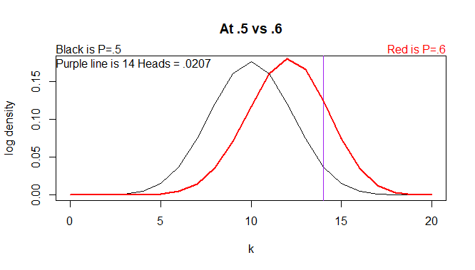
POWER

